Slide 1

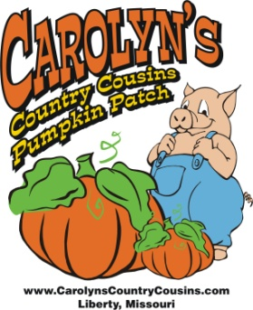
Sprouting New Ideas for your Agritourism Venue
Carolyn’s Country Cousins
Pumpkin Patch
Carolyn and Buddy Raasch
March 2021

Slide 2
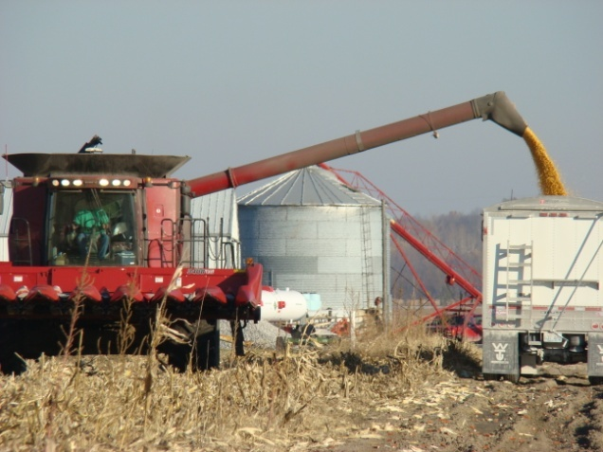
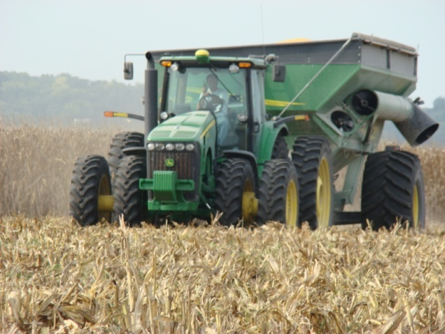
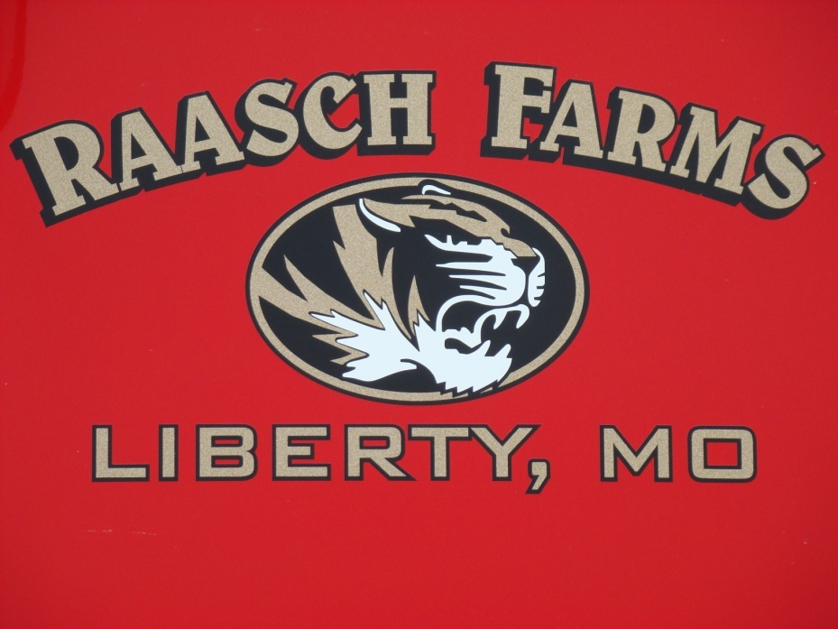
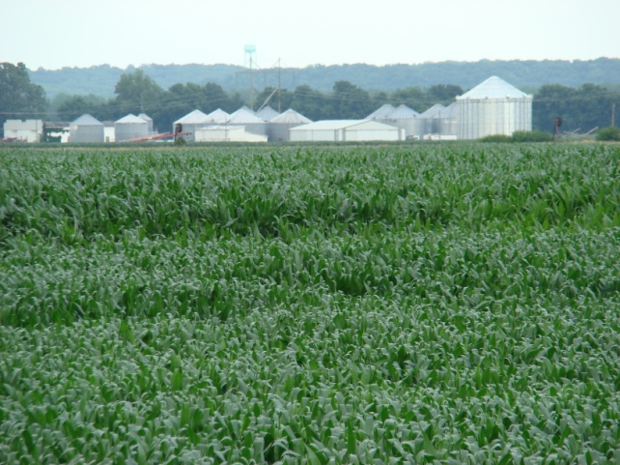
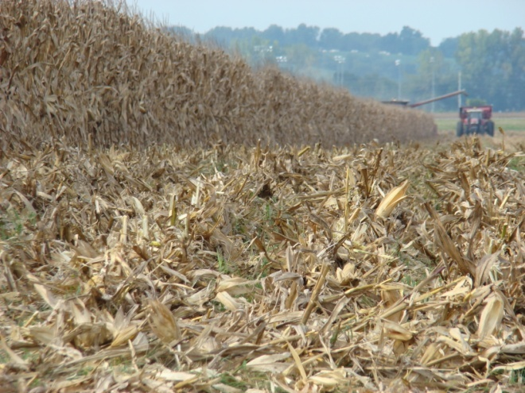
Traditional Farmers

Slide 3
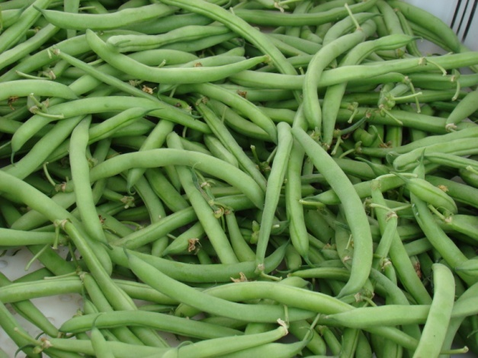
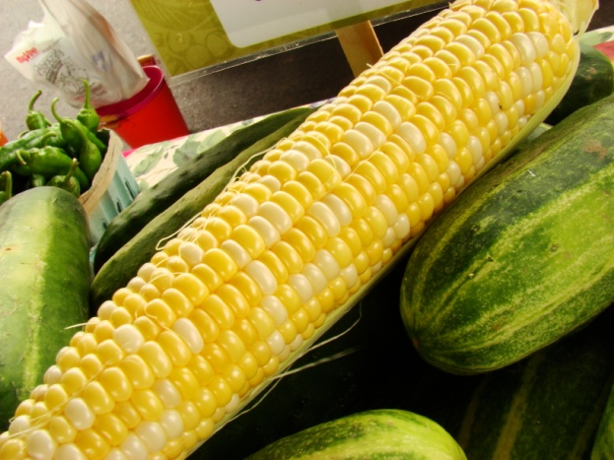
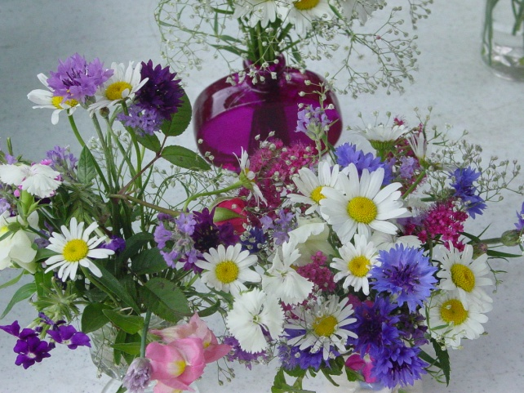
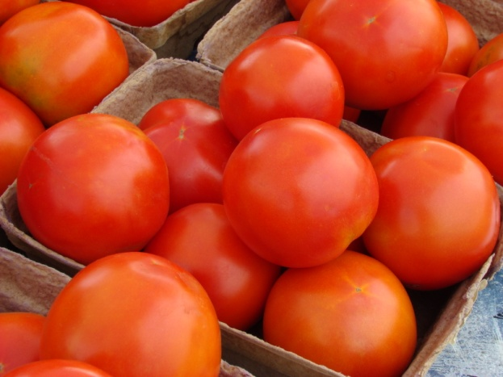
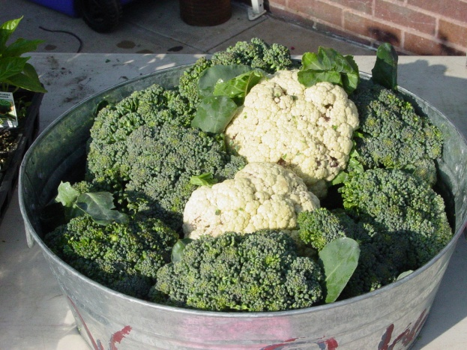
Traditional Garden

Slide 4
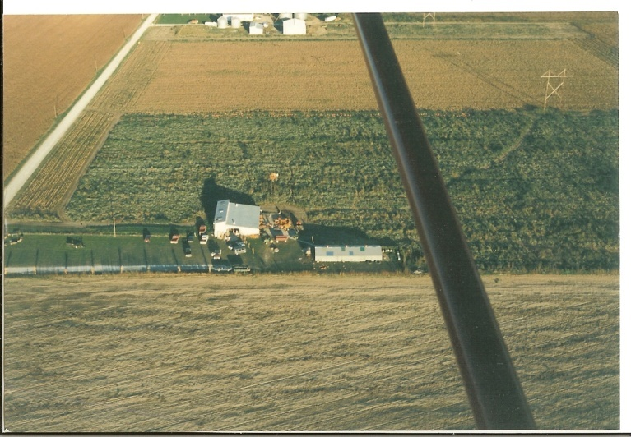
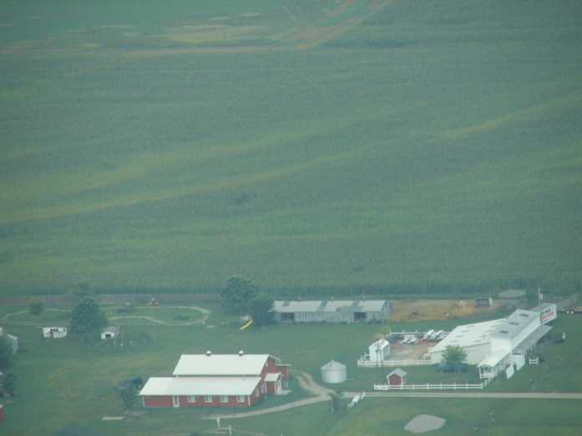
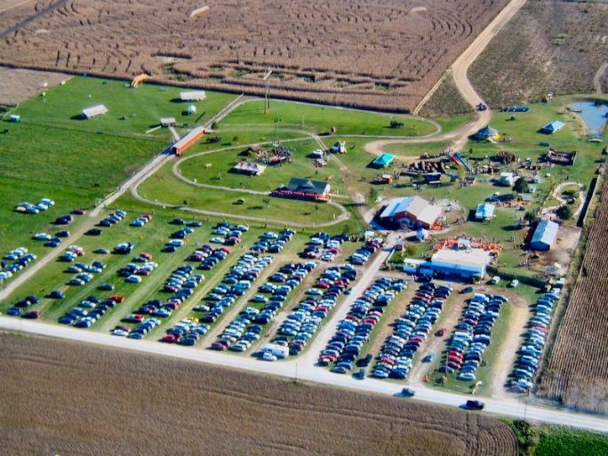
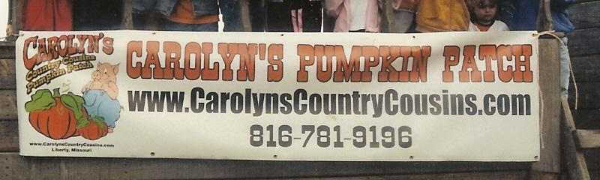
Carolyn’s Country Cousins

Slide 5

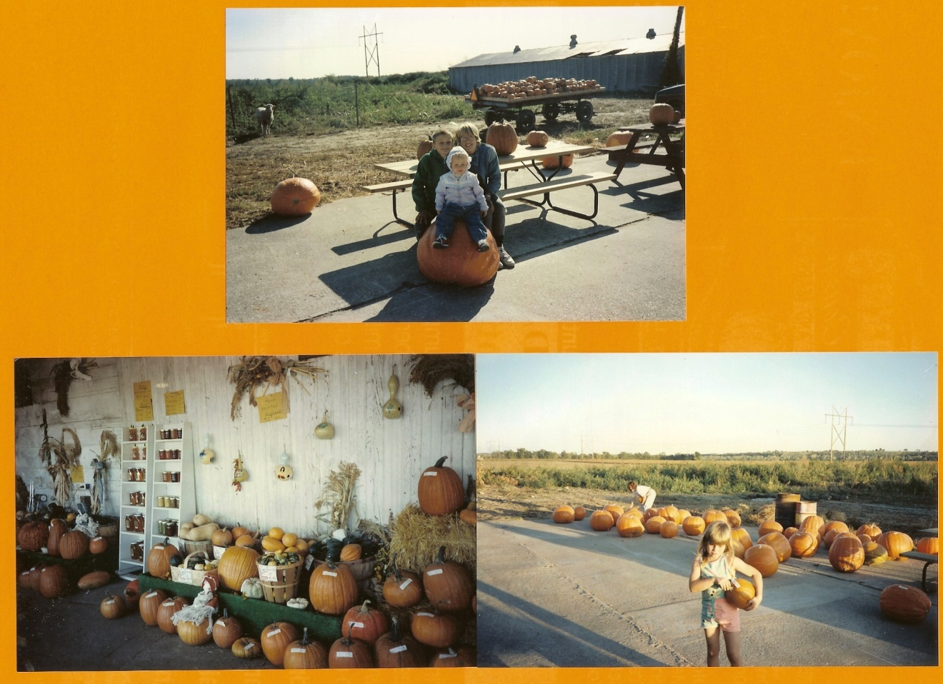
Our Story
Started In 1991
Small garden pumpkin patch
Handful of school tours

Slide 6
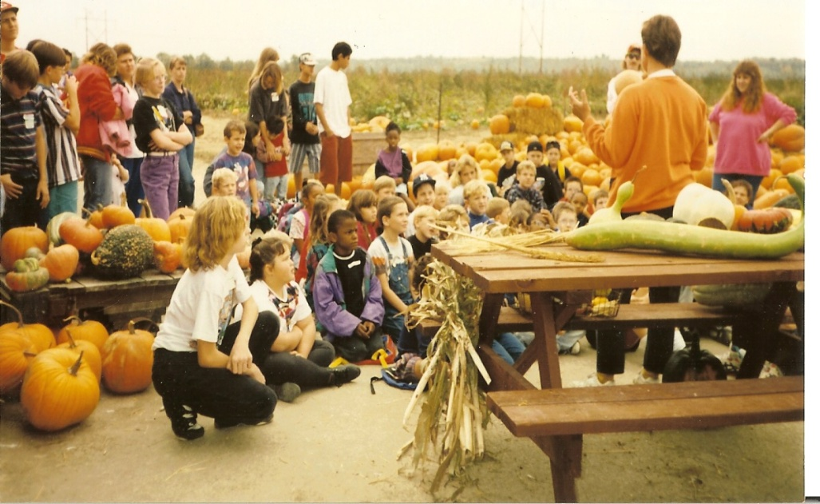
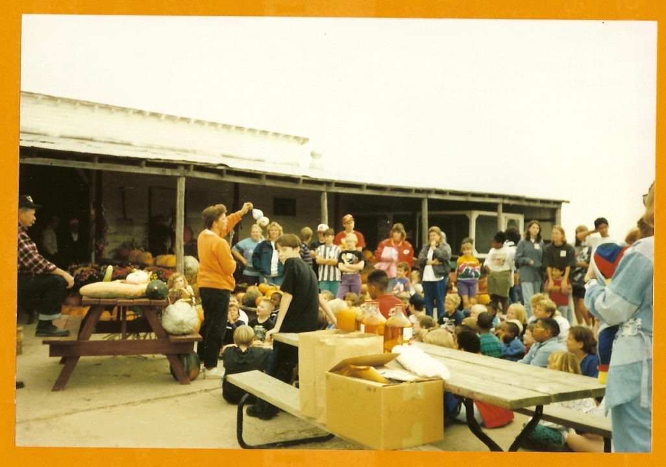
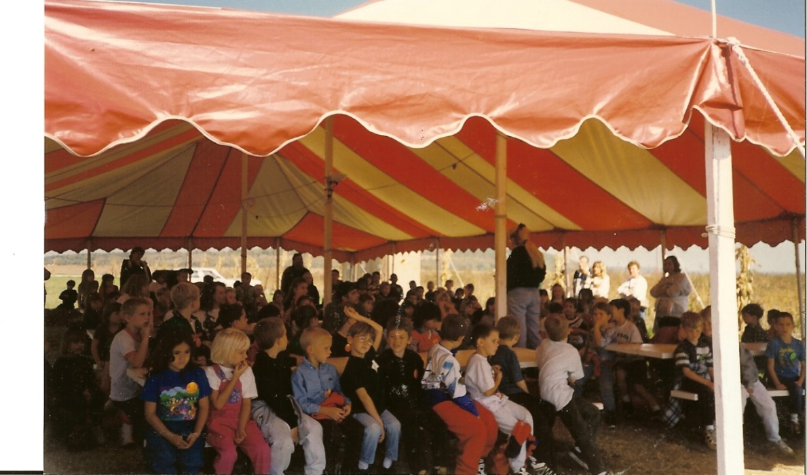
Notes:
Top Pictures – 1991
Bottom Picture - 1996

Slide 7
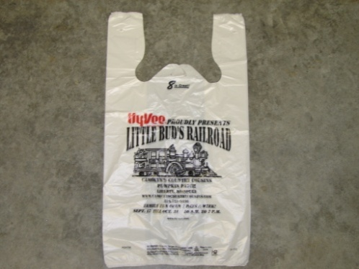

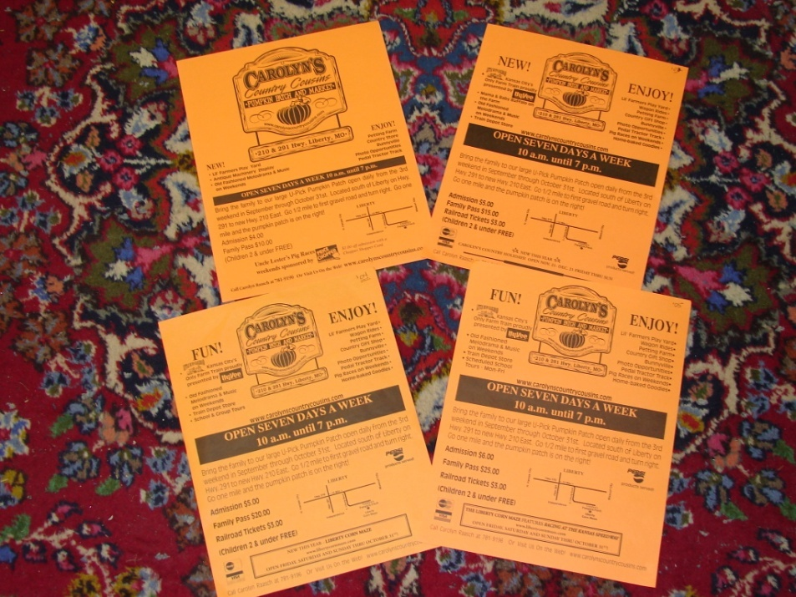
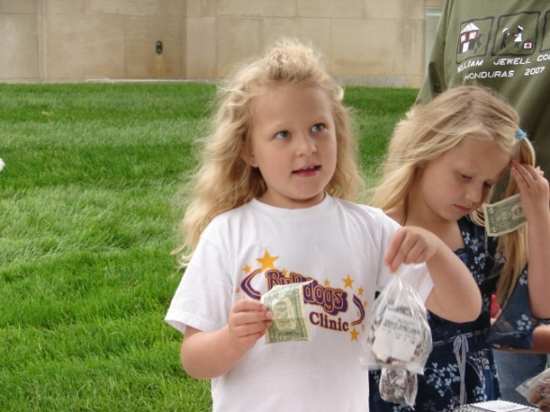
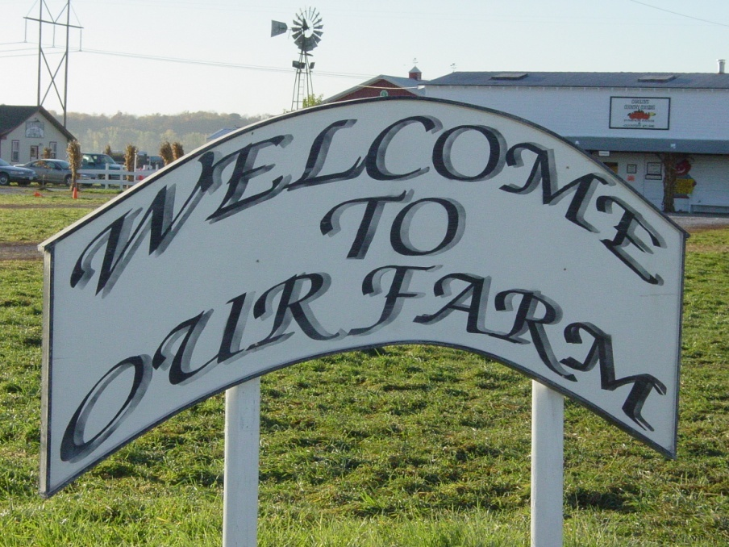
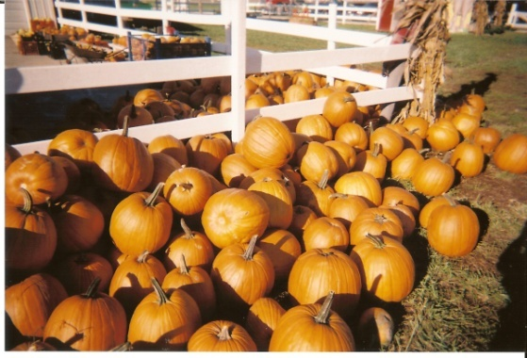
Transition
Notes:
2002 Little Bud’s Railroad

Slide 8
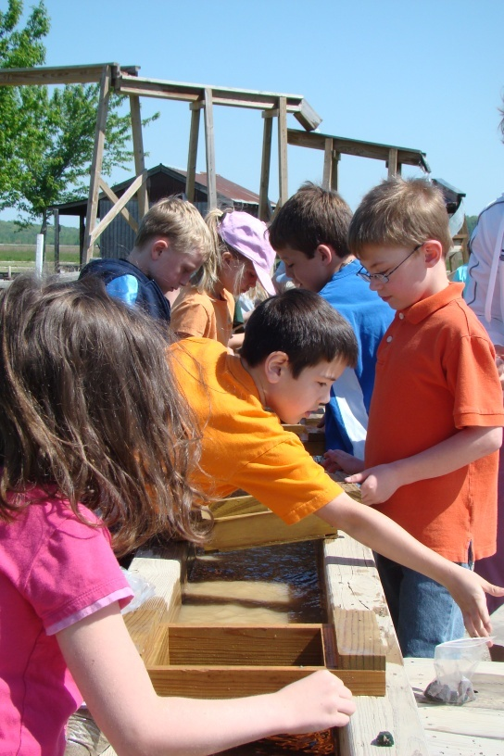
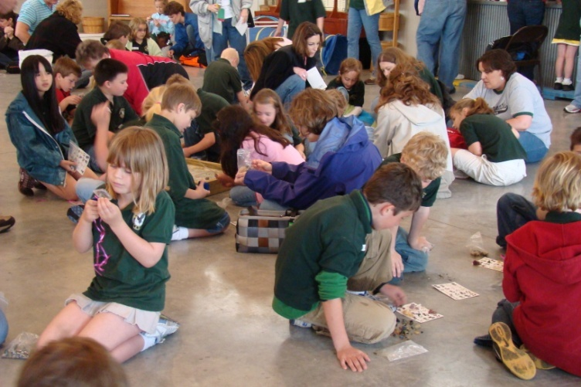
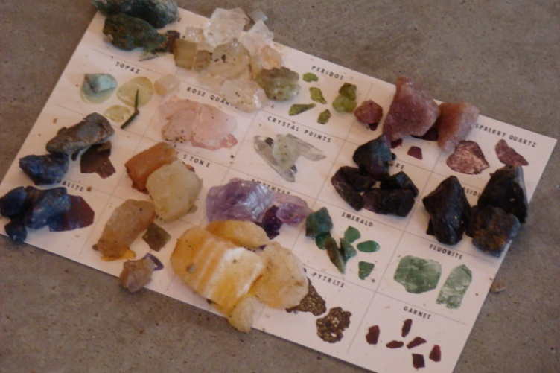
Uncle Earl’s Mining Camp new 2006
Earth Science teachers needed a field trip w/ an educational and entertaining theme for rocks and minerals. Everything we come in contact with either has to be mined or farmed. It is a natural bond.

Slide 9
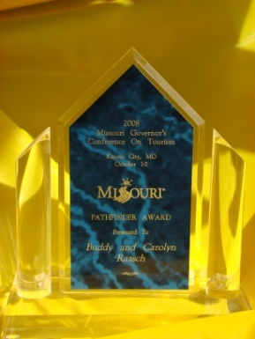
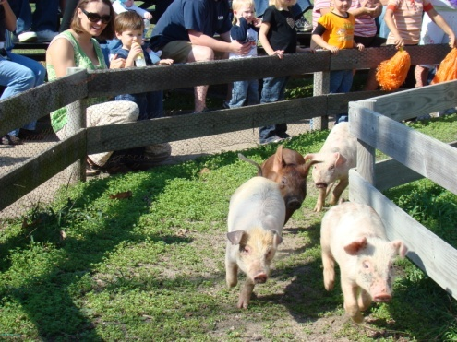
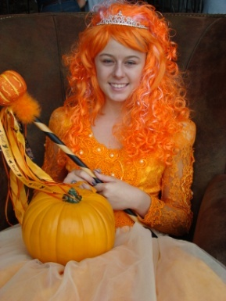
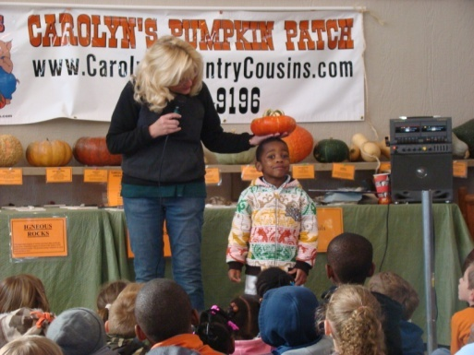
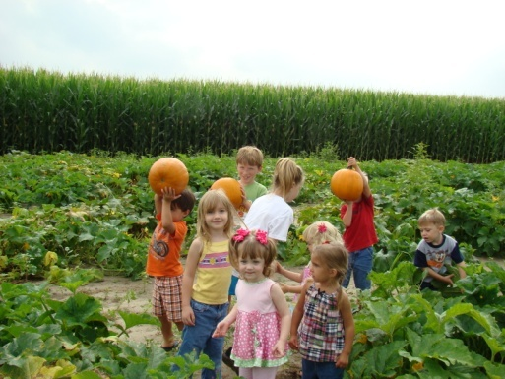
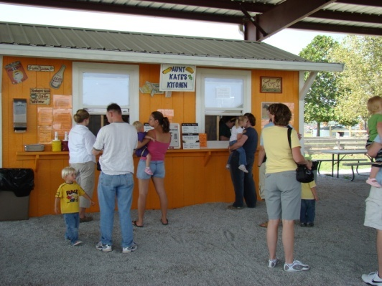
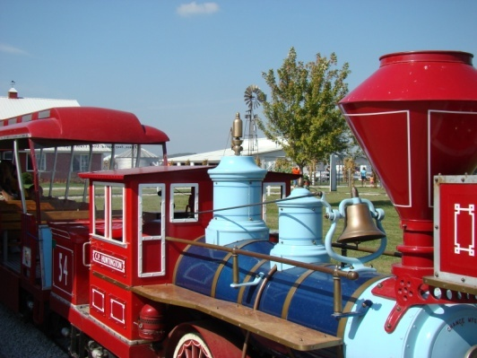
2010
60 acres of U-pick Pumpkins
110,000 general admission
16,000 School and group tours

Slide 10
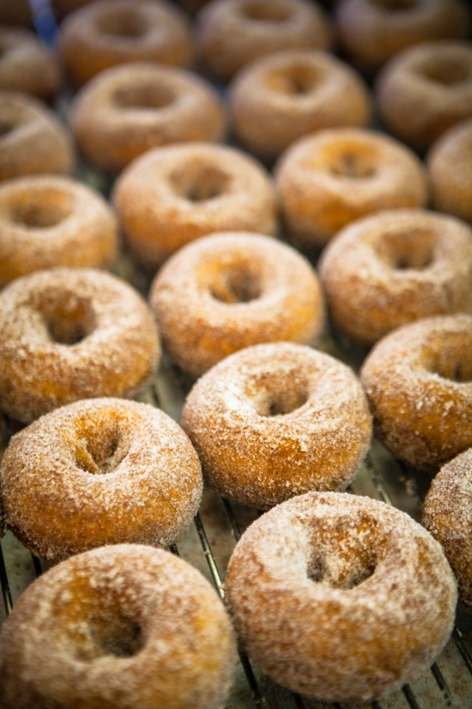
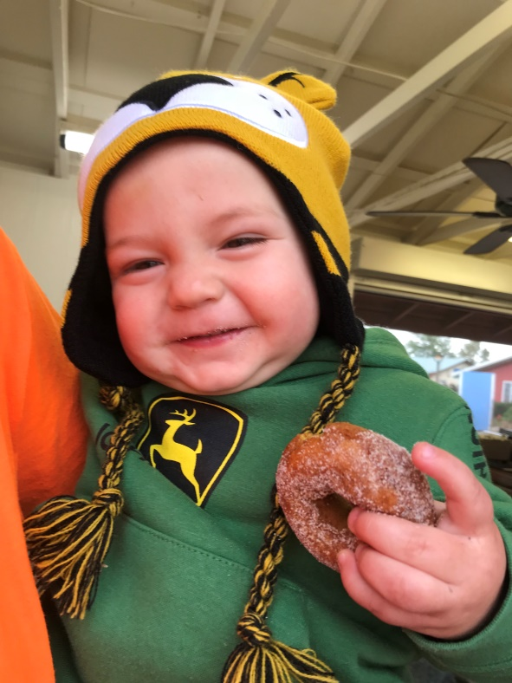
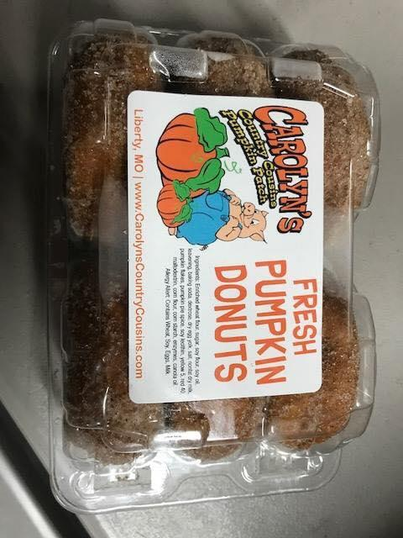
DONUTS DONUTS DONUTS
We are well known for our donuts -
In 2019 we made over 10,000 donuts in 1 day
2020 built a new larger donut house and got a Belshaw Mark 6
Notes:
Went from a Mark 2 to two Mark 5’s to now a Mark 6

Slide 11
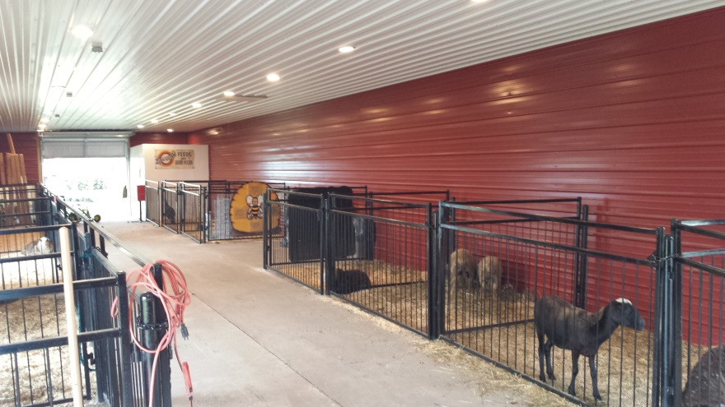
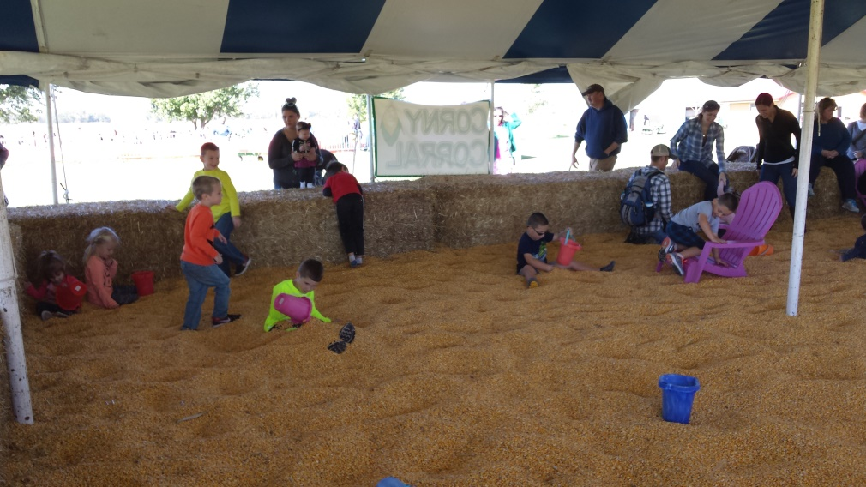
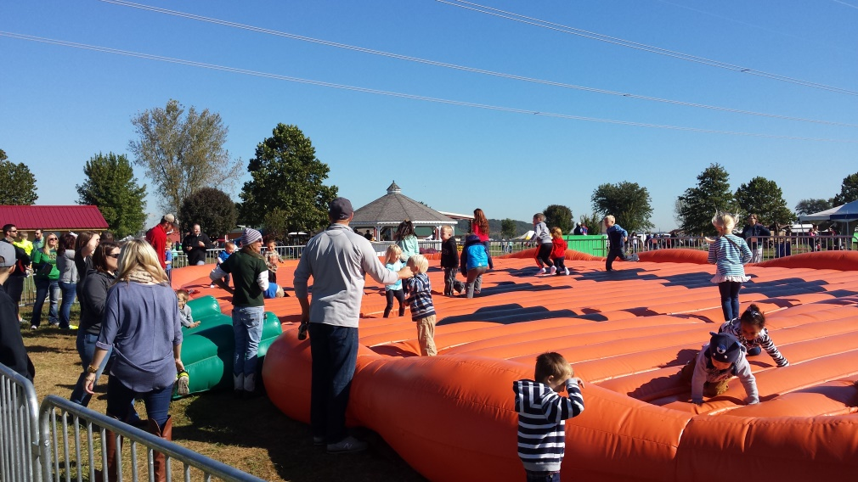
2016
Redid Animal Barn
Added Pumpkin Jumping Pad
As of 2020 we now had 1 Pumpkin Jumping Pad and 2 jumping pillows
Corny Corral

Slide 12
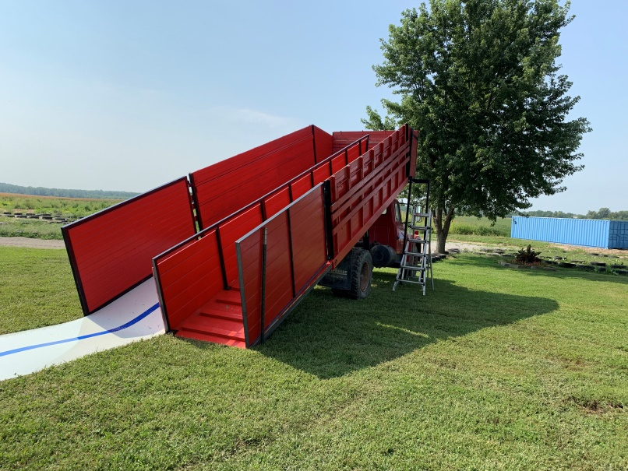
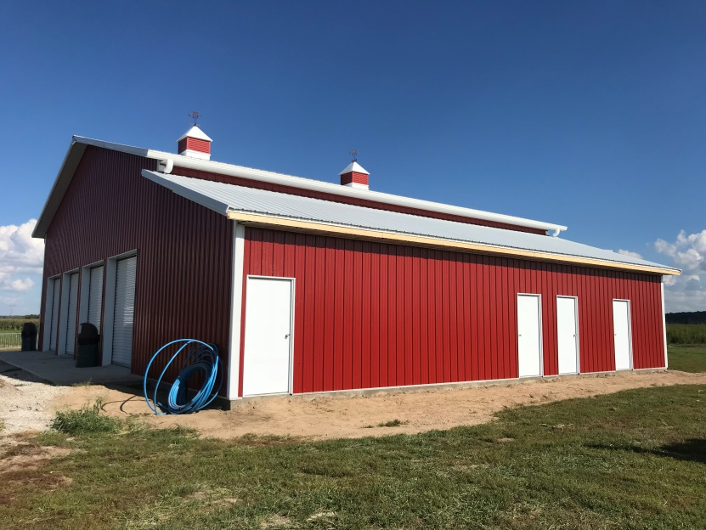
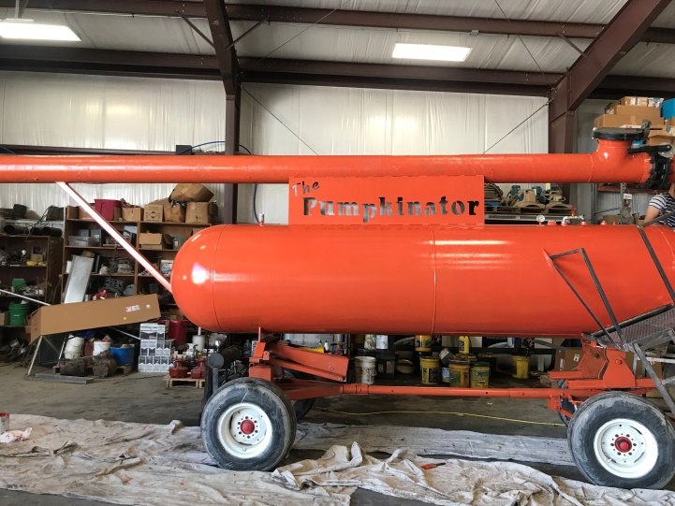
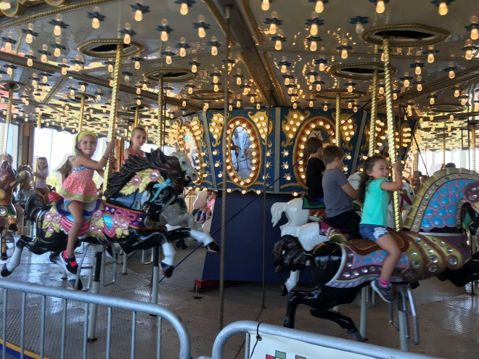
2018-2019
New building for the Country Carousel -2018
New Permanent Bathrooms 2019 HUGE amenity for our customers
2019 put in a larger bar with wine slush and a variety of craft beer – parents LOVE this

Slide 13
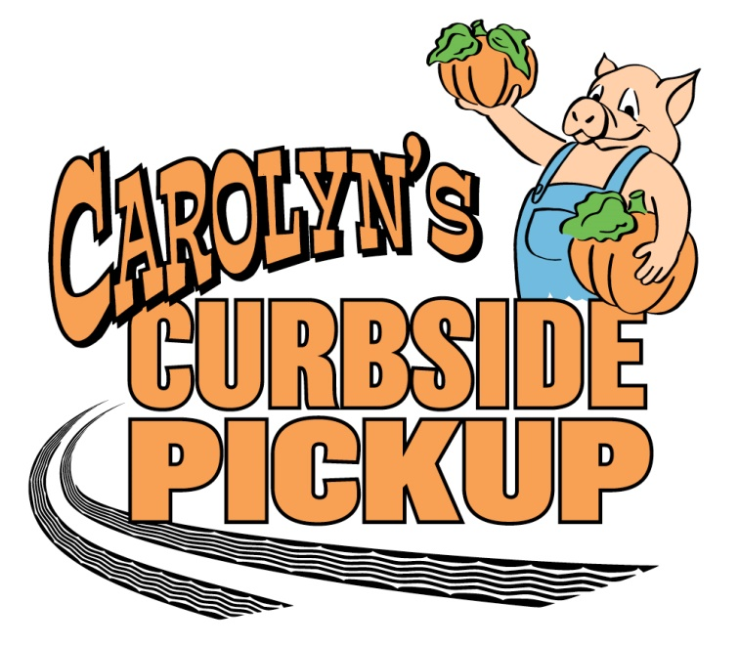
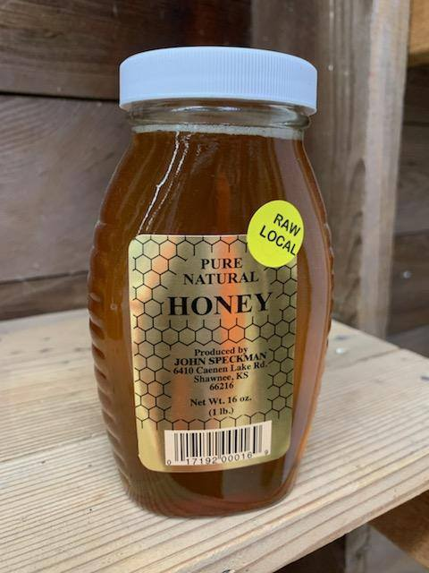
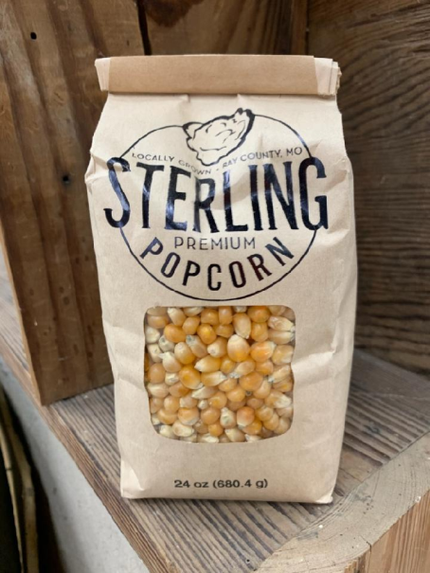
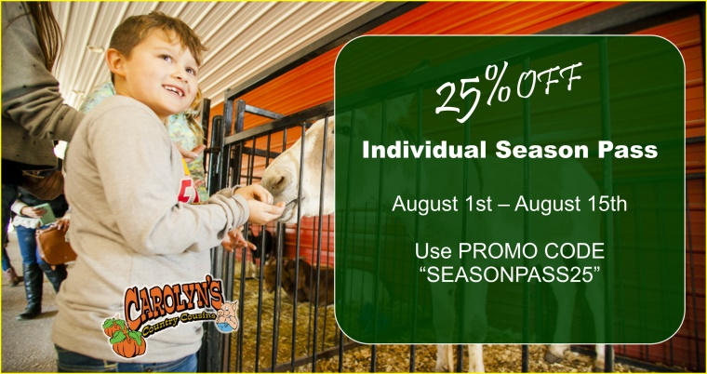
COVID 2020 Changes
ONLINE TICKETING
Individual Season passes
Carolyn’s Curbside
Sanitation Crews
Minimal School Tours – did we miss them?
Local, Local , Local – people want it
Close down 1 day per week?

Slide 14
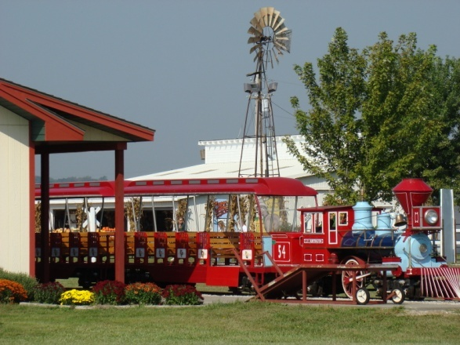
Outside of the Ordinary
Listen and respond
Research
Members of a variety of organizations
Goal to be Unique yet thematic
  Little Bud’s Railroad
  Uncle Lester’s Pig Races
  Events – car show, music, etc.
  Pumpkin Princess
  Country Carousel

Slide 15
How We Think Outside of the Box
Listen
  Comment Cards
  Emails
  Our visitors
Research
  Visit other sites
Members of a variety organizations
  NAFDMA
  Local Chamber of Commerce
  Kansas City Attractions Association
  Among others

Slide 16
How We Built Our Operation
Up to Be Successful
Grew Carefully each year – start small & build slowly
Add Something new every year
Quality in what we do
Seek to improve what we do all the time
Upkeep the old and keep it great – one of the hardest aspects of an aging agritourism business
Keep our focus – we can’t be everything to everybody
Contribute and be involved at a variety of levels in our community

